Slide 1
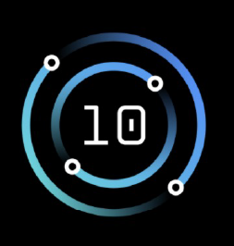
IBM Power10 virtualization, management and automation — Ian Robinson Power software product management leader idrobinson@us.ibm.com

Slide 2



Power virtualization stack: Evolving with Power10
In 2022, the IBM Power virtualization and automation stack will continue to be optimized to support the expanding family of IBM Power10 enterprise servers.
This stack forms the foundation of leading Power-based public clouds, as well as thousands of mission-critical enterprise deployments in customer datacenters worldwide.
Ansible
Enterprise IT Automation
Private Cloud and VM Lifecycle Management
CMC
Virtualization, Service and Hardware Management
HMC
vHMC
Virtualization Management
NovaLink
Virtualized I/O
VIOS
Hypervisor (in firmware)
IBM Power10 Enterprise Servers
Notes:
The Power architecture has unique advantages over commodity server platforms such as x86, because the engineering teams working on the processor, motherboards, virtualization and management appliances collaborate closely to ensure an integrated stack that works seamlessly. This approach is in stark contrast to the multi-vendor x86 approach, where the processor, server, management and virtualization must be purchased from different (and sometimes competing) vendors. The Power stack engineering teams are once again partnering closely to deliver the next-generation Power10 enterprise server platform, resulting in an IT architecture with industry-leading performance, scalability and security. Every layer in the Power stack is being refreshed, updated and optimized to make Power10 the platform of choice for mission-critical enterprise workloads.

Slide 3
Power software updates enhance new Power10 models
HMC and vHMC V10R1M1020
Cloud Management Console (CMC) 1.17
PowerVM 3.1.3 SP
(includes VIOS 3.1.3 SP)
PowerVC 2.0.3
Notes:
Supporting the Power10 scale-out server release will be the updated HMC/vHMC V10R1M10120, along with updates to CMC, PowerVM, VIOS and PowerVC.

Slide 4
Power virtualization milestones for 2022
Q1 2021
Q2 2021
Q3 2021
Q4 2021
FW 1020 (PHYP)
VIOS 3.1.3.21 SP
CMC 1.17
HMC V10 R1 M1020
vHMC V10 R1 M1020
V 2.0.3
V 2.0.3 (Fixpack)
AIX Enterprise Edition v1.8
Private Cloud Edition v1.8
Notes:
The releases of HMC, vHMC, PowerVM, VIOS and PowerVC delivered in April 2021 were the final updates for the Power9 platform. The next wave of updates for the Power virtualization and management stack support the new generation of Power10 servers. This includes the current HMC/vHMC V10R1M1010 (which supports the FW1010 firmware release) the forthcoming HMC/vHMC V10R1M1020 (which supports the FW1020 firmware), PowerVM 3.1.3 (with VIOS 3.1.3) and PowerVC 2.0.3. With the addition of support for the Power10 platform, support will be dropped for the Power7 platform, consistent with the IBM Power policy of supporting three processor generations (Power8, Power9 and Power10).

Slide 5
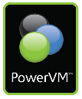

PowerVM builds upon IBM’s virtualization heritage
A 50-year track record in virtualization and cloud innovation continues with PowerVM
1967
1973
1999
2004
2008
2010
2014
2018
2022
IBM Research develops hypervisor that becomes VM on the mainframe
IBM announces systems with physical partitioning
IBM announces LPAR on POWER™
IBM debuts POWER Hypervisor™ for System p™ and System i™
IBM ships PowerVM Editions
PowerVM delivers enhanced storage virtualization
PowerVM enabled for OpenStack integration
PowerVM built into all Power9 enterprise servers
PowerVM provides foundation for Power10 generation
Notes:
IBM has a long history of leadership and innovation in the field of virtualization. This is not a new technology – it has been around since 1967 on the mainframe, and was first developed for the POWER processor back in 1997. Since then IBM has continued to refine the technology to make it more reliable, scalable and better serve the business needs of clients. With the latest Power10 generation of servers, PowerVM is built into the firmware, ensuring that every Power workload is fully virtualized, mobile and cloud-enabled.

Slide 6
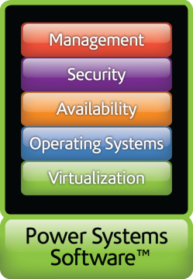
How PowerVM delivers virtualization benefits
Deploying a virtualized workload with PowerVM is simple:
Create a new PowerVM virtual machine (VM)
Install the operating system (AIX, IBM i or Linux) in the VM
Install the workload application(s) in the VM
Configure the operating system and applications as required
The VM can now be easily stored, moved, copied or modified !
Benefits of virtualizing workloads with PowerVM include:
Extreme consolidation – many diverse workloads can be hosted on one server
Rapid provisioning – deploying a ready-to-run workload is quick and easy
High scalability – deploying multiple copies of a workload type is simplified
Easy recoverability – restoring a workload after an outage is fast and reliable
Notes:
Creating a virtualized workload in PowerVM is similar to setting up a new server, except that it only needs to be done once. After that, deploying an identical workload is as simple as copying a file, saving many hours of repetitive admin work and minimizing the risk of errors. Virtualizing workloads also makes it easier to provision, scale, and recover from system outages. Fully-virtualized, fully-mobile workloads are essential for cloud-based infrastructure, so creating VMs is always the first step in deploying an effective cloud solution.

Slide 7
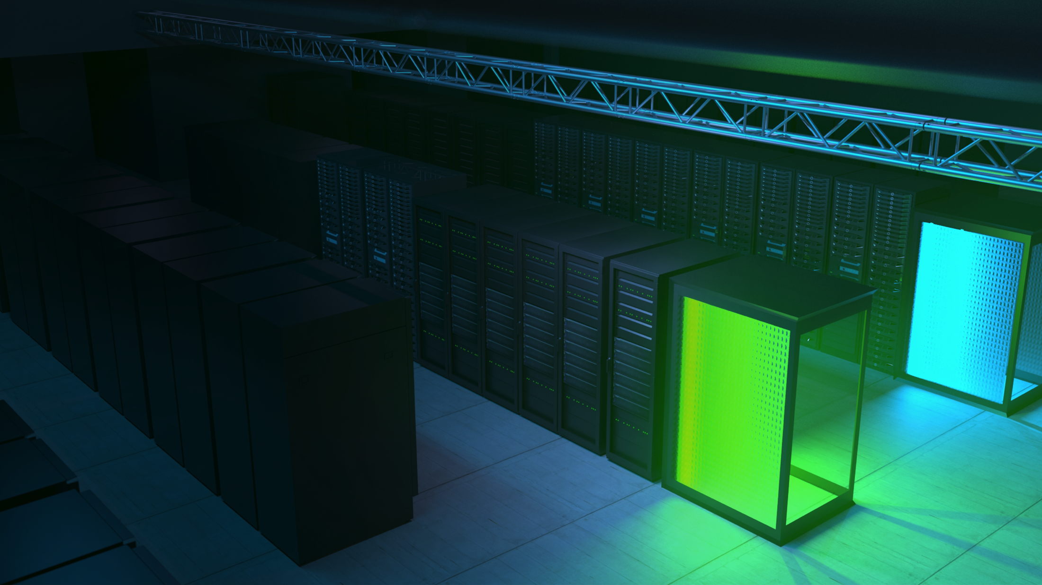

PowerVM is built into all cloud-ready Power10 servers
Every Power10 workload is virtualized, mobile and fully cloud-enabled

Slide 8
PowerVM 3.1.3
LPM for Power10
LPM between Power8/9/10, with secure accelerated LPM between Power9/10 servers.
Active Memory Mirroring (AMM)
With the FW1020 firmware release, AMM is now supported across all Power10 models, including scale-out servers (previously AMM was limited to high-end and midrange servers).
Common Criteria (CC) EAL 2
As the focus on cybersecurity continues to intensify, PowerVM and VIOS will receive this globally-recognized security certification at the EAL 2 level, providing customers with confidence in the security of the Power10 infrastructure.
Notes:
The new Service Pack (SP) for the PowerVM 3.1.3 release comprises an update of the PowerVM hypervisor (built into the Power10 server firmware installed on the motherboard) and an updated VIOS 3.1.3 (a pre-built VM that provides virtualized I/O capabilities). As well as adding support for Power10 servers, these components include several performance and configuration enhancements that have been requested by Power customers.

Slide 9

Power10 support for PowerVM VIOS releases
2017
2018
2019
2020
2021
2022
2023
2024
2025
AIX 7.2 Based
VIOS 3.1.3
Sept 2021
Q3 2021
SP
SP
SP
SP
SP
SP
SP
SP
SP
SP
SP
SP
SP
SP
SP
SP
SP
SP
SP
SP
SP
SP
SP
SP
SP
SP
SP
SP
SP
7.2 based
AIX 7.2 Based
Power10
VIOS 3.1.2
Nov 2020
Q3 2022
SP
SP
SP
SP
SP
SP
SP
SP
SP
SP
SP
SP
SP
SP
SP
SP
SP
SP
SP
SP
SP
SP
SP
SP
SP
SP
SP
SP
SP
AIX 7.2 Based
VIOS 3.1.1
Nov 2019
Q3 2022
SP
SP
SP
SP
SP
SP
SP
SP
SP
SP
SP
SP
SP
SP
SP
SP
SP
SP
SP
SP
SP
SP
SP
SP
SP
SP
SP
SP
SP
VIOS 3.1.0
Nov 2018
AIX 7.2 Based
SP
SP
SP
SP
SP
SP
SP
SP
SP
SP
SP
SP
SP
SP
SP
SP
SP
SP
SP
SP
SP
SP
SP
SP
SP
SP
SP
SP
SP
EoS
AIX 6.1 Based
VIOS 2.2.6
Oct 2017
SP
SP
SP
SP
SP
SP
SP
SP
SP
SP
SP
SP
SP
SP
SP
SP
SP
SP
SP
SP
SP
SP
SP
SP
SP
SP
Extended support
End of Support:
Sept 30 2020
Marketed and serviced
Fee-based service extension
ifix’s only, no new HW enablement
Technology Level (TL)
Service Pack
End of standard support
SP
A new VIOS Release / Technology Level is typically released once per year
Service model is 3 years of standard support (Service Packs and i-fixes) for each VIOS release
All statements regarding IBM's future direction and intent are subject to change or withdrawal without notice, and represent goals and objectives only
Notes:
While it is IBM Power support policy to support three VIOS versions, the initial Power10 release supported only the new VIOS 3.1.3 at the time of launch (September 2021). However, support for the prior VIOS 3.1.1 and 3.1.2 will be added in 2022, allowing enterprise customers the ability to standardize VIOS across their Power datacenters and migrate at a time of their choice. Many Power customers run their most mission-critical enterprise workloads on the Power platform, and therefore they prefer to adopt a systematic, cautious and controlled approach to migrating those workloads to the latest Power stack.

Slide 10

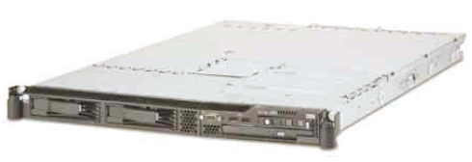
IBM Power HMC 7063-CR2
19” Rack, 1 Socket 1U Form Factor
One Power9 chip, 6 cores, 130W
128 GB Max memory
16, 32 GB RDIMMS (2 configs: 4x16GB=64GB, or 4x32GB=128GB)
77 GB/s peak memory BW per socket
2 x 1.8TB SAS SFF 2.5-inch hard disk drive (HDD) RAID 1
Integrated 4x 1G baseT (one port for shared management)
2 x 10 Gb Ethernet ports on optional PCI adapter
Two USB 3.0 hub ports in front of server (option to remove)
Two USB 3.0 hub ports in the rear of the server
RAS:
Concurrent maintenance disks
Redundant Hot plug 900W power supplies
Redundant cooling w/Hot Swap capability
Simplified Op panel
In-rack system service
Customer Setup and Install
IBM Service/Support
HMC code level V10R1M1020
Manages Power8, Power9 or Power10 servers
No support for servers using Power7 processor-based systems on this code level – three generations of Power servers are supported
Two Rail Features Available:
Fixed Length Rail kit
Required if rack ship
Rack (S42, T42, T00)
Adjustable Length Rail kit
7063-CR2 compatible with flat panel console kits 7316-TF3, TF4, and TF5
7316-TF3 and TF4 have both been withdrawn from market
Notes:
The Hardware Management Console (HMC) is a physical management appliance for Power servers, delivered in a 1U rack-mount format.

Slide 11
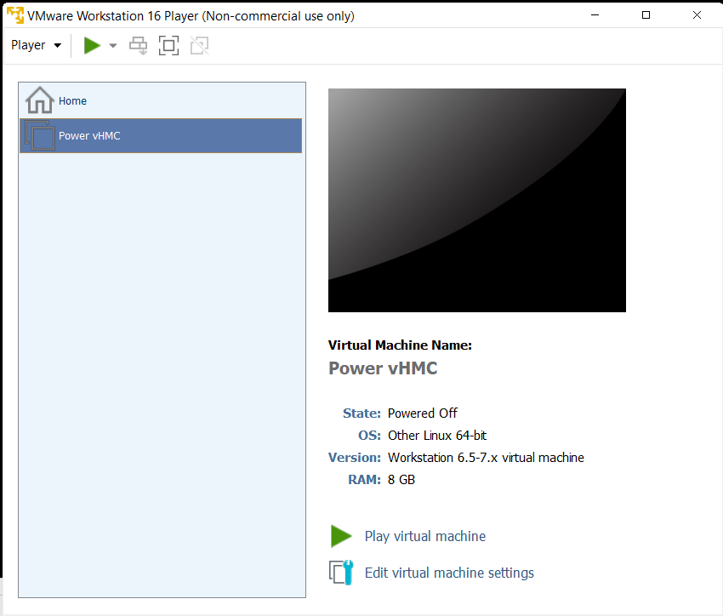
IBM Power vHMC
Power vHMC formats
5765-HMW (x86)
VMware, KVM or Xen
5765-HMB (Power)
PowerVM
Deployment options
Single vHMC
Dual vHMC
Single HMC
Dual HMC
Mixed: HMC and vHMC
(Maximum of two per server)
IBM Power vHMC is a pre-built virtual machine (VM) that offers identical Power server management capabilities to the physical HMC appliance.
Available for popular virtualization platforms on x86 or Power, the vHMC is updated in alignment with physical HMC and Power server firmware updates.
IBM Power customers can download the latest vHMC version and simply launch the VM, without the need for guest OS installation.
After connecting to the managed Power server(s), vHMC operation is identical to using the HMC.

Slide 12
Power seller recommendations
Power vHMC formats
5765-HMW (x86)
VMware, KVM or Xen
5765-HMB (Power)
PowerVM
Deployment options
Single vHMC
Dual vHMC
Single HMC
Dual HMC
Mixed: HMC and v
(Maximum of two per server)
Lead with vHMC, citing the advantages (TCO, convenience, compliance, etc.)
If customer requires redundancy, two vHMCs can be deployed (on different hosts for resilience)
If customer prefers a physical HMC appliance, note that a vHMC can be added for redundancy
HMC
vHMC pricing ($US)
5765-HMW (x86) - $3000
5765-HMB (Power) - $3000
Annual SWMA renewal
1 year - $600
3 years - $1800
HMC
vHMC
HMC
vHMC
vHMC
Management cost
Best TCO!

Slide 13
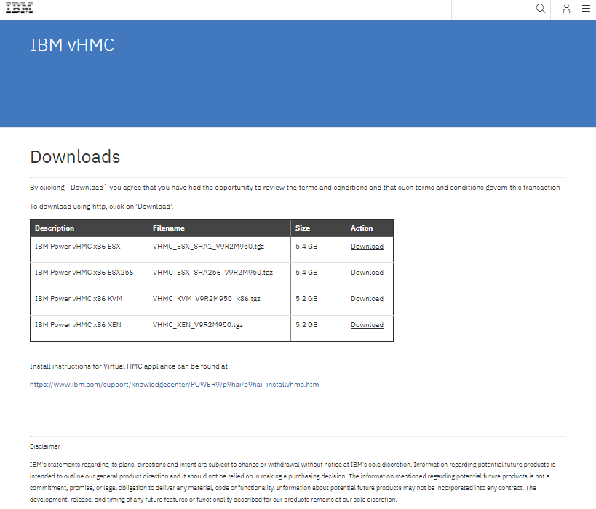
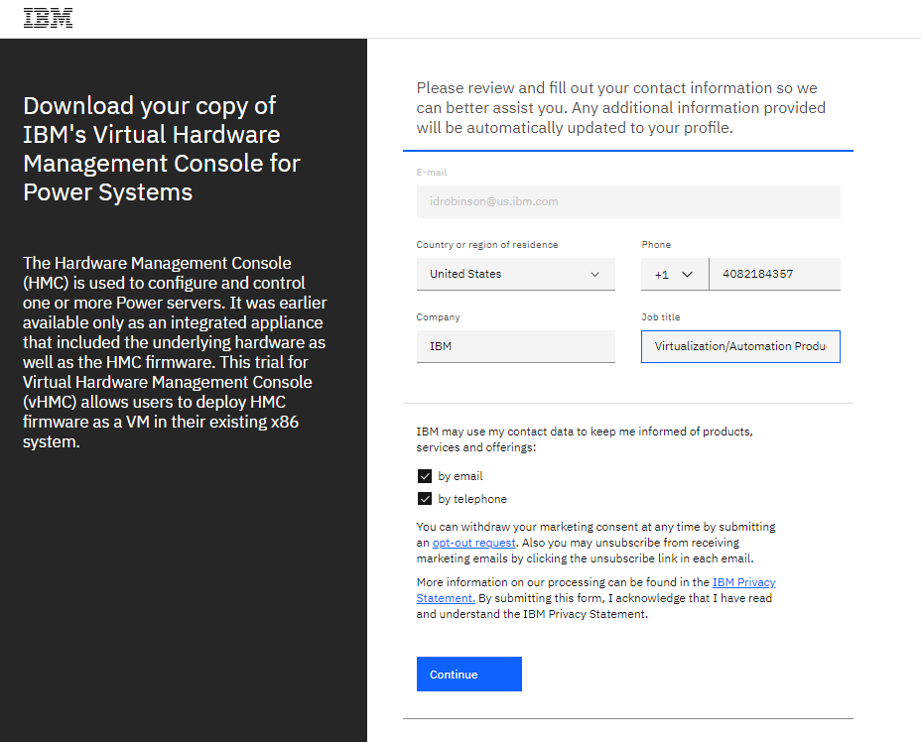
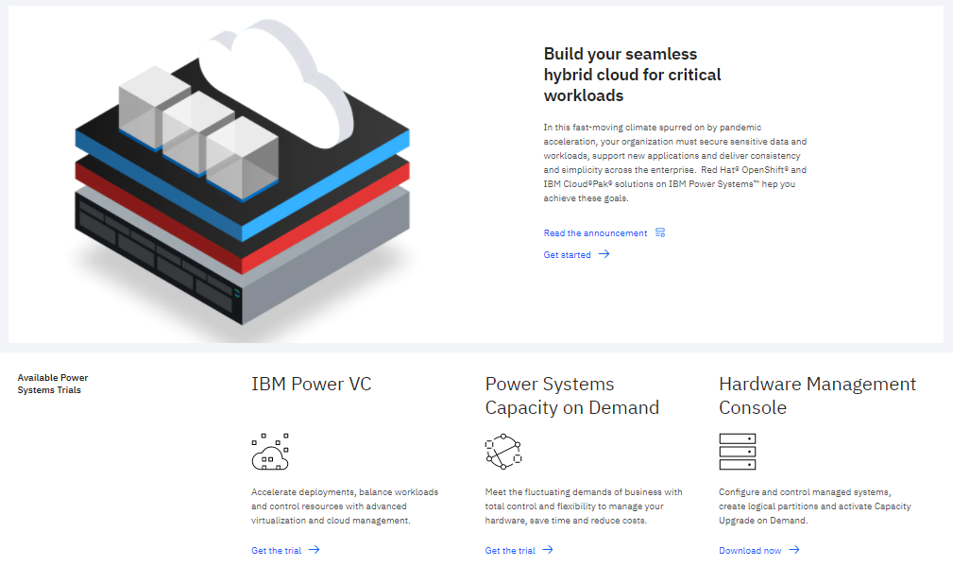
IBM Power vHMC Free Trial Download
Power vHMC trial linked from Trials section of IBM Power Web site
https://www.ibm.com/it-infrastructure/power
Download requires acceptance of clickthrough license agreement
https://www.ibm.com/account/reg/us-en/signup?formid=urx-50076
Try/Buy license allows seamless transition to production deployment

Slide 14

Maintaining IBM Power HMC currency is critical
In recent years, cybersecurity has emerged as a global infrastructure security issue and an increasingly critical concern for CIOs and enterprise IT managers.
The IBM Power architecture has always ranked highly in terms of end-to-end security, which is why it remains a platform of choice for mission-critical enterprise workloads.
A key aspect of maintaining a secure IBM Power environment is ensuring that the HMC (or vHMC) is current and fully supported (including hardware, software and Power server firmware updates).
Outdated or unsupported HMCs represent a technology risk that can quickly and easily be mitigated by upgrading to a current release of the HMC or vHMC.
7063-CR2 IBM Power HMC V10R1M1020
5765-VHP IBM Power vHMC V10R1M1020
5765-VHX IBM Power vHMC V10R1M1020
https://www.whitehouse.gov/briefing-room/presidential-actions/2021/05/12/executive-order-on-improving-the-nations-cybersecurity/
14
Notes:
In the past, many IBM Power customers have held onto outdated HMC appliances for many years beyond the end of support (EOS) dates. This represents a technology and security risk, due to the inability to diagnose and fix defects or vulnerabilities in unsupported hardware, software and firmware. Recent prominent malware and ransomware attacks have focused on organizations using outdated hardware and technology stacks with known unpatched vulnerabilities. The Power HMC is the primary gateway to thousands of mission-critical enterprise workloads running on IBM Power infrastructure worldwide, and therefore it is critical for CIOs and IT administrators to ensure that their HMCs and vHMCs are current and supportable.

Slide 15
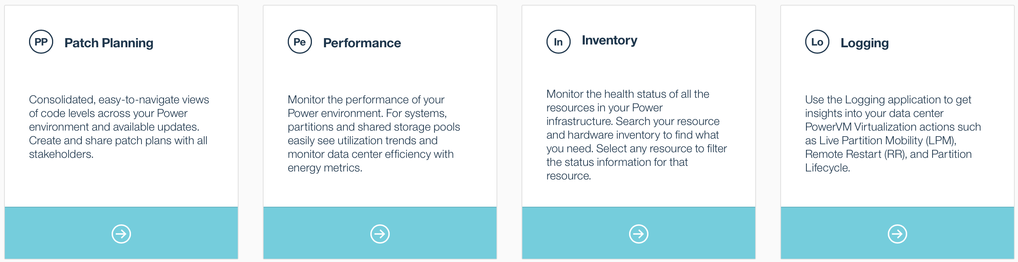
IBM Cloud Management Console (CMC)
The IBM Cloud Management Console (CMC) is a SaaS-based manager that provides a consolidated view of Power-based deployments, spanning multiple regions and datacenters.
CMC provides a comprehensive inventory of systems and virtualized resources, consolidated performance data to optimize utilization and performance across multiple Power-based data centers, and aggregated logging information for additional insights.
Delivered as a SaaS offering from the IBM Cloud, CMC offers convenient pay-as-you-go multi-cloud management. A one-year CMC entitlement is included with Power E1080 servers.

Slide 16


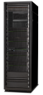




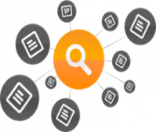
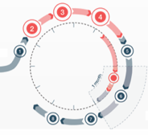
CMC connects HMCs to the Cloud
Cloud-based microservices that can be accessed securely, anytime, anywhere for the entire enterprise
As data centers scale out and up, the need increases for a complete view of the Power infrastructure
IBM Cloud
HMC
HMC
HMC
Inventory Aggregation
Performance Monitoring
Log Trends
Patch Planning
View all Power Systems, HMCs, VMs, etc. across the entire enterprise
See basic health & state
Aggregated performance across Power enterprise
Energy monitoring
OS metrics
Log aggregation
Telemetry
Patch compliance reports for firmware, HMC, NovaLink, VIOS, and OS
Scheduled maintenance plan management

Slide 17

IBM Power Shared Utility Capacity
How it works Purchase servers with Base capacity.
Variable demand addressed by buying Capacity Credits for Metered capacity.
IBM Cloud Management Console with HMC automatically monitors and debits against Capacity Credits for actual resource usage by the minute.
Which servers?* Deploy across a pool of Power9 or Power10 systems.
Handle demand spikes across collections of Power servers with Base and Metered Capacity, which includes:
Processor activations
Memory activations
Metered by the minute
Pool #1
Metered
System B
Base
System A
System C
Optimize costs with dynamic, pay for use pricing.
All processor & memory resources are fully activated.
Notes:
As more enterprises look at ways to reduce costs while maintaining the scalability required to stay competitive in today's fast-paced business environment, pay-as-you-go or consumption-based infrastructure models have grown increasingly popular. These purchase models enable clients to quickly scale their IT infrastructure up or down to optimize costs while quickly adapting to dynamic business environments. To maintain a competitive advantage, you need an IT model that helps you adapt rapidly to the changing tech landscape.
That's where a consumption-based IT thrives because it:
Balances the flexibility of cloud infrastructure with the control, security, and reliability you'd expect from your on-premises data centers
Pays for IT resources and capacity on demand, reducing up-front CapEx and other costs associated with traditional procurement processes (that is, energy, cooling, etc)
Enables rapid infrastructure expansion to accommodate the needs of new projects and workloads
All these benefits contribute to a greater alignment between business and IT leaders, and when both sides of an organization are aligned, you're better prepared to deliver innovative products and services to your customers. Regardless of industry or company size, the shift to consumption-based IT is clear.
IBM Power Enterprise Pools 2.0 delivers enhanced multisystem resource sharing and by-the-minute consumption of on-premises compute resources for clients deploying and managing a private cloud infrastructure. This flexibility combined with the Power Systems’ security, reliability, and scalability provide clients with the consumption-based-IT solution required in today's dynamic, hyper-competitive market. Power Enterprise Pools 2.0 simplifies system management, so clients can focus on optimizing their business results instead of moving resources around within their data center. Resources are easily tracked and monitored by the IBM Cloud™ Management Console with HMC, which automatically tracks usage by the minute and debits against Capacity Credits based on actual usage. With Power Enterprise Pools 2.0, clients no longer need to worry about over-provisioning capacity to support growth.
Highlights :
All installed processors and memory on servers in a Power Enterprise Pool (2.0) are activated and made available for immediate use when a pool is started. There is no need to reallocate mobile resources from server to server.
System capacity may be seamlessly made available when it is needed without requiring human awareness or intervention.
Permanent, Capacity Upgrade on Demand processor and memory activations (Base Capacity) and corresponding license entitlements are purchased on each Power system. These Base Processor and Memory Activation resources are then aggregated across a pool.
Unpurchased (inactive upon shipment) processor and memory capacity in the pool is activated when a pool is started and can subsequently be used on a pay-as-you-go basis (Metered Capacity) from Capacity Credits purchased from IBM or an authorized IBM Business Partner.
Processor resource within a pool is tracked by the minute, based on actual consumption by shared processor partitions.
Memory resource within a pool is tracked by the minute, based on the assignment of resources to partitions, not based on operating system usage of the memory.
Metered Capacity consumption on one system may be offset by idle Base Capacity elsewhere in the pool during the same period.
A single Power Enterprise Pool (2.0) may support up to 1,000 shared processor partitions across up to 32 Power systems with a maximum of 500 VMs per HMC within a single enterprise, within a single country. There may be multiple Hardware Management Console (HMC) concurrent connections to CMC per Power system.
Each Power Enterprise Pool (2.0) is monitored and managed from a Cloud Management Console in the IBM Cloud.
Capacity Credits may be purchased from IBM, an authorized IBM Business Partner, or online through the IBM Entitled System Support website, where available.
Clients may more easily identify capacity usage and trends across their Power systems in a pool by viewing web-accessible aggregated data without spreadsheets or custom analysis tools.
The Enterprise Pools 2.0 application provides features to:
Start a pool
Add Power systems to a pool
Set a monthly budget for Metered Capacity consumption
Analyze total or Metered minutes, Capacity Credits, core, memory, or operating system resource usage
Monitor Base and Metered Capacity used within a pool over time
Analyze trends within a pool and adjust time scale to review by minutes, hours, days, weeks, or month
Drill down within a selected time period to see more detailed usage by VM
Show Capacity Credits consumed and breakdown usage by resource within a pool
Display Capacity Credit balance, budget status, Metered resource rate table, and Capacity Credit purchase history
Monitor and maintain monthly Capacity Credit budget
Tailor alerts and thresholds for a pool based upon budget and resource consumption
Both core and memory usage are tracked and charged by the minute. Both are based on the average usage for one minute and not the peak usage during the minute.
Core usage is tracked based on actual consumption by partitions.
Memory usage is tracked based on the assignment of memory to partitions and is not tracked based on the operating system usage of the memory. Only memory assigned to active partitions is tracked and charged.

Slide 18
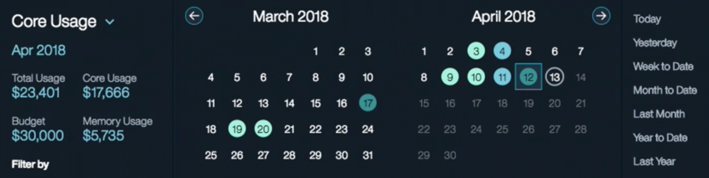
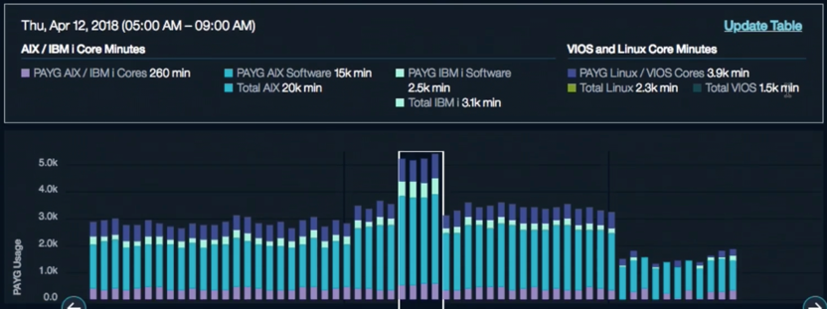
Cloud Management Console 1.17
Hybrid cloud inventory and monitoring of PowerVS VMs
• Alerts and notifications for inventory and patch planning
• Addition of an include list option for monitoring systems
• Infrastructure and cloud connector updates
• Support for handling different application programming interface (API) keys for IBM Cloudant
• Chargeback (one-minute interval) and post-pay for IBM Power Private Cloud Metered Capacity
• Accessibility compliance
• Angular update to latest supported level for currency
• Filebeat and logstash update for currency
• Purge option for logging data
• Red Hat CoreOS (OpenShift) metering
Notes:
Cloud Management Console (CMC) is a cloud-delivered solution that is updated multiple times each year by way of an agile continuous delivery process. This includes the latest 1.17 update, released in support of the latest Power10 server models, which includes multiple customer-requested enhancements.

Slide 19


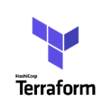
PowerVC virtualization and private cloud management
PowerVC API provides integration with ecosystem partners
LAMA
vRealize
for Private Cloud
Key Features:
Deploy VMs in minutes
Full lifecycle management of VMs
Automated VM recovery
Single-click host evacuation
Automated cloud optimization
Multi-tenancy and resource isolation
OpenStack API enablement
Open integration with multi-cloud managers
Key Features:
EVERYTHING in PowerVC … plus …
Self-service, single-click deployment for cloud users and developers
Policies, metering and quota management to govern how the private cloud operates
Web-based portal for Power private cloud management
Import/export VMs to/from clouds

Slide 20
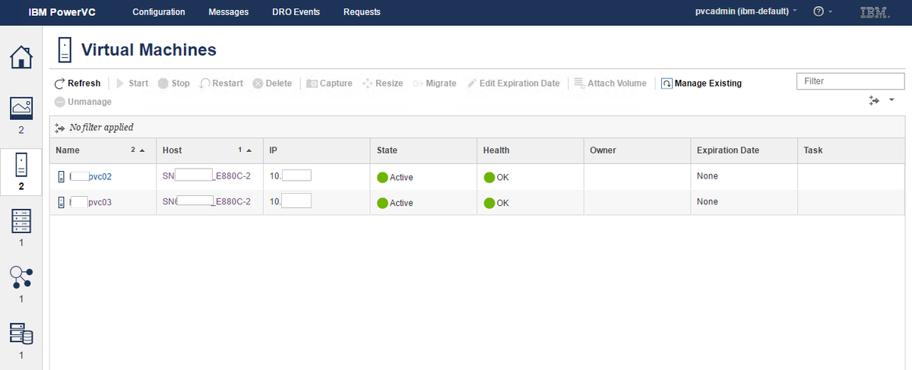
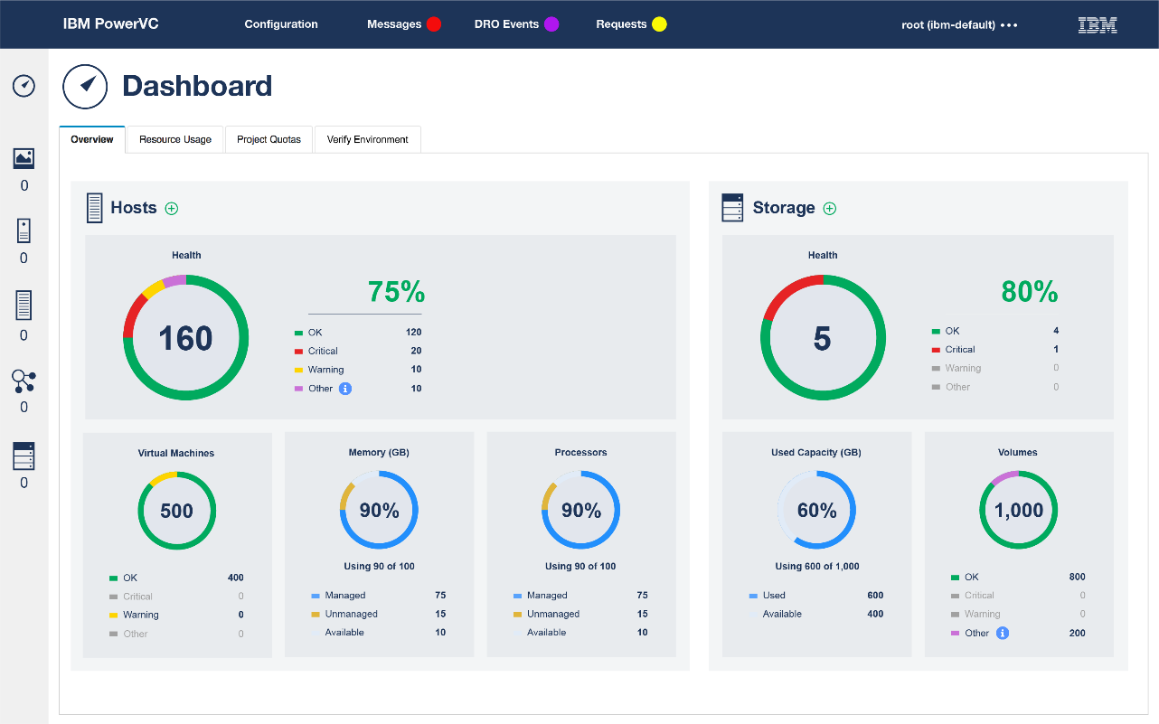
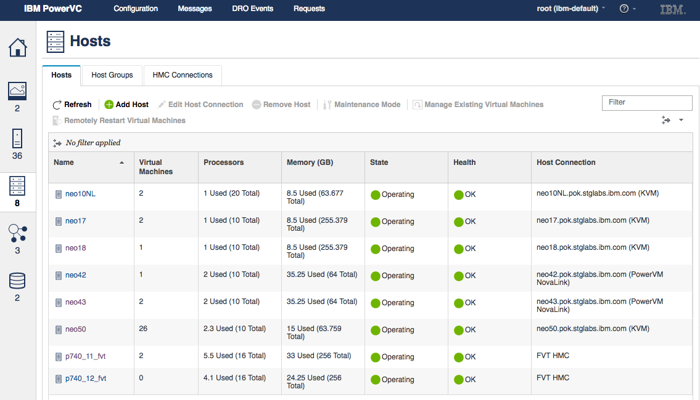
PowerVC: Complete lifecycle management for VMs
PowerVC provides comprehensive virtualization and private cloud management for Power servers and integration with multi-cloud managers

Slide 21
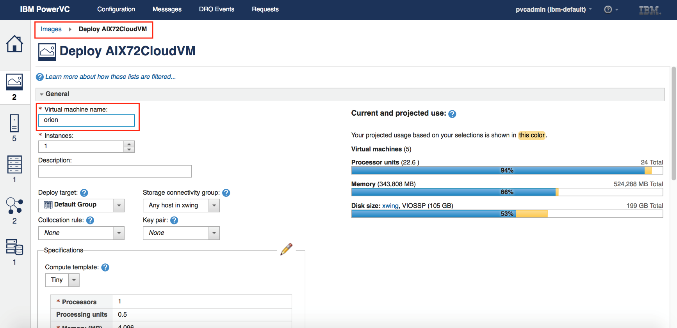
PowerVC for Private Cloud: Self-service portal
PowerVC for Private Cloud provides a simplified user experience for developers or other Power private cloud users requiring self-service VM provisioning and management
The PowerVC for Private Cloud self-service portal provides cloud users with capabilities that include:
One-click deploy templates
Approvals and expirations
Role-based access control
Project-based resource isolation (multi-tenancy)
Metering and e-mail notifications

Slide 22
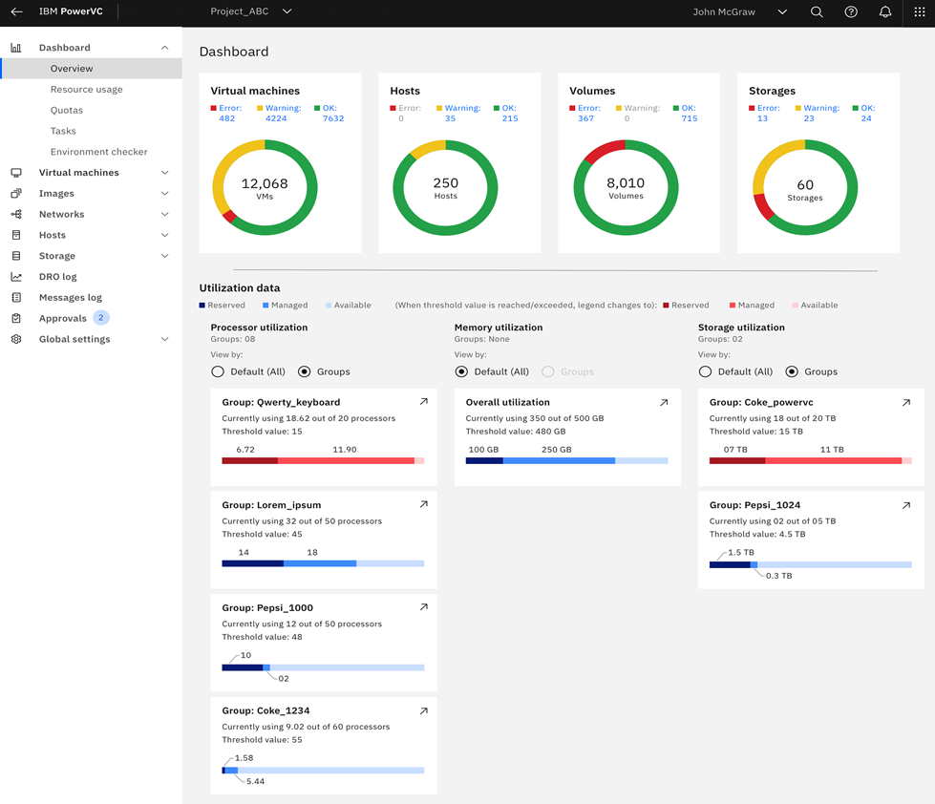
PowerVC 2.0.3
New features and enhancements
Scale PowerVC manager up to 5-node cluster
Backup and restore for multi-node management
Scheduled tasks for self-service users
UI performance and design enhancements
Support for registration when endpoint is down
Update managed endpoint IP or VIP address
Notes:
In addition to supporting the next generation of Power10 servers, the new PowerVC 2.0.3 release includes many significant enhancements that have been requested by the thousands of Power customers worldwide who depend upon PowerVC for their day-to-day virtualization management and private cloud capabilities.

Slide 23
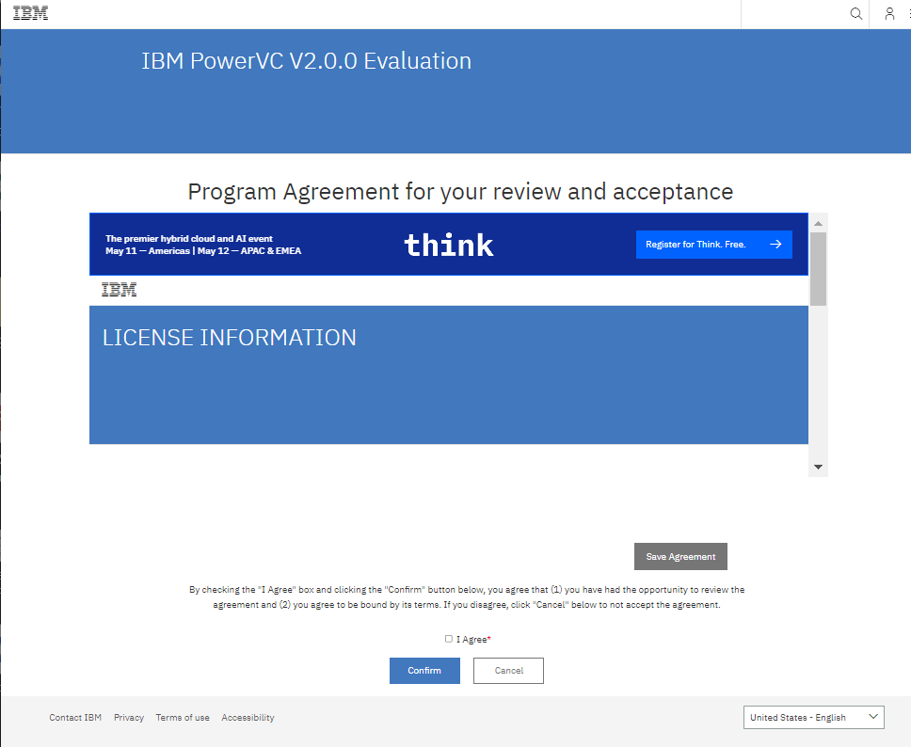
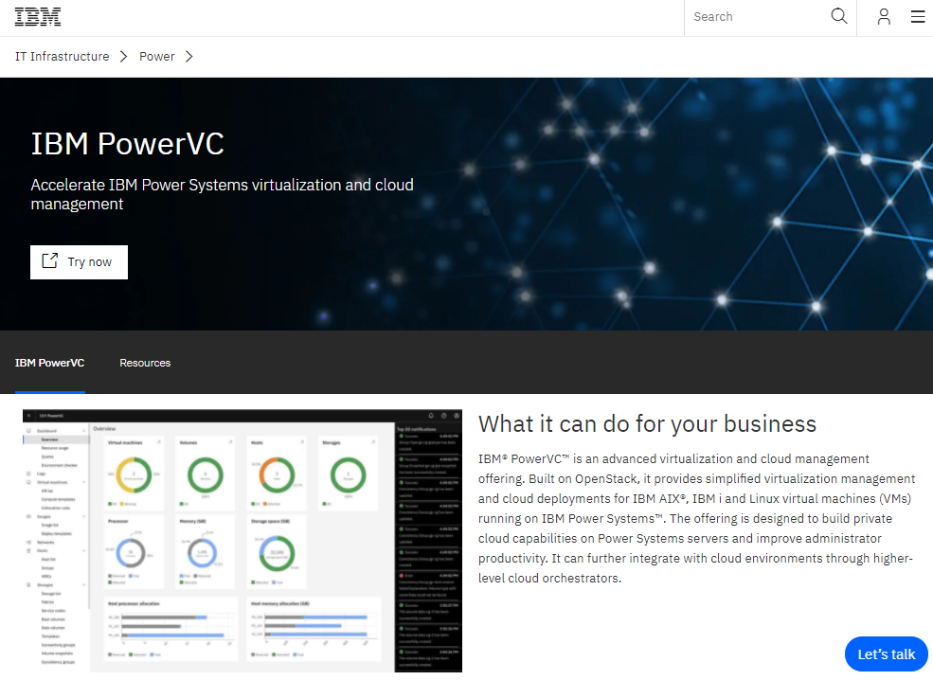
PowerVC Trial Download
PowerVC 2.0.3 trial linked from Try Now button on product page
https://epwt-www.mybluemix.net/software/support/trial/cst/programwebsite.wss?siteId=1138&h=null&p=null
Download requires acceptance of clickthrough license agreement
Try/Buy license allows seamless transition to production deployment
Notes:
PowerVC is available for customer trials and PoCs, by way of the included download link, which requires customer identification and a click-through Try/Buy license agreement.

Slide 24
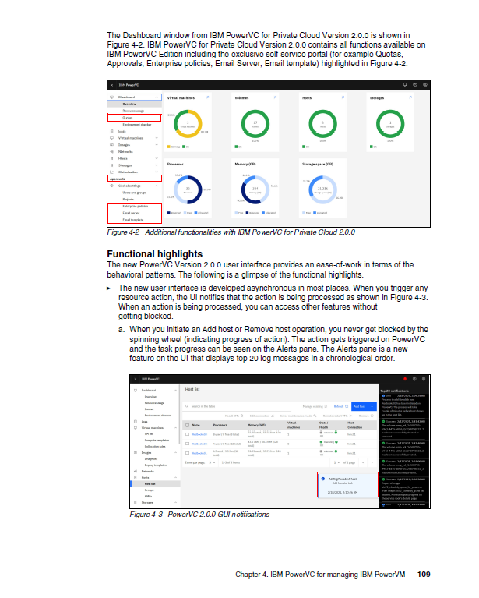
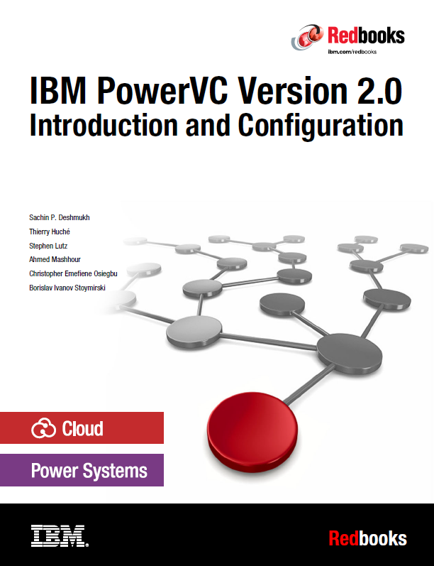
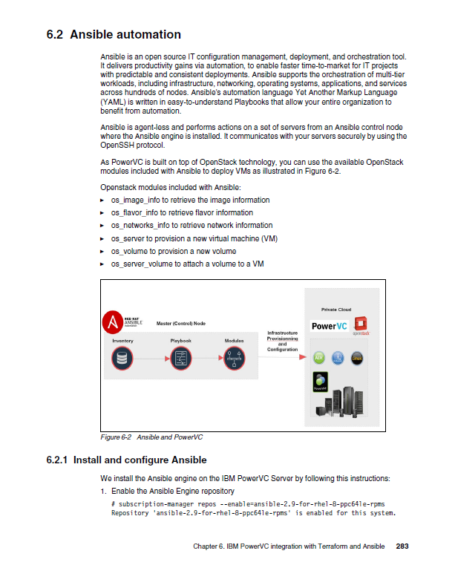
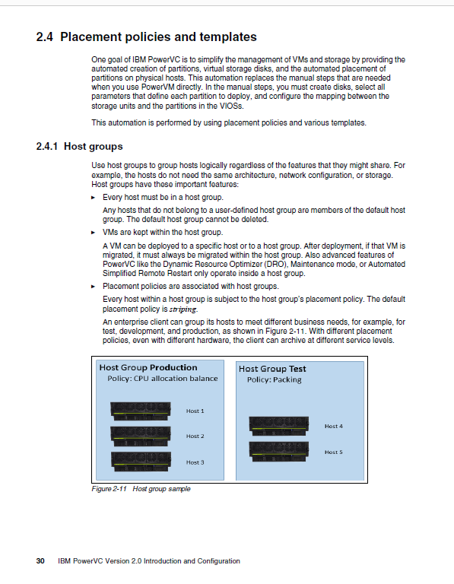
PowerVC 2.0 Redbook
ISBN-10: 0738459739 ISBN-13: 9780738459738 IBM Form #: SG24-8477-00 (368 pages)
https://www.redbooks.ibm.com/abstracts/sg248477.html?Open
Notes:
For those customers seeking more technical details on how to effectively deploy PowerVC, an IBM Redbook is available for download.

Slide 25
Ansible automates repetitive IT management tasks
Rolling out system software updates
Ensuring that all servers stay configured properly and meet compliance requirements
Validate correct security baseline is in place
Provisioning software stacks within SLAs
Automate deployment and management
Increases productivity of AIX, IBM i and IBM Power admins
Extends consistent management across multiple platforms
Notes:
Ansible is the industry-leading configuration management and automation software, which competes in the same market as products such as Puppet, Chef and Salt. Ansible is based upon open source code that is among the top ten most popular open source projects globally, and Red Hat offers a commercially supported enterprise version known as Red Hat Ansible Automation Platform.
Ansible uses an ‘agentless’ design that makes it easy to many a multitude of platforms, operating systems and IT architectures, including IBM Power. Any task that can be performed by an IT administrator using a command line script can be packaged up into an Ansible module for repeated execution across multiple endpoints (or VMs) and combined with other modules into an Ansible playbook.
Ansible playbooks are executed by the Ansible Engine back end, which connects to each of the managed endpoints or VMs. One or more Ansible Engines can be controlled by Ansible Tower, which provides a graphical dashboard view of the complete Ansible environment.

Slide 26



Benefits of IBM Power automation with Ansible
Improved efficiency via the simplification and standardization of complex IT deployments and enterprise automation strategies
Visibility of your automation – know what is being automated, when, and by whom
Simplicity increases productivity with certified collections that codify system-specific knowledge and complexity
Notes:
Automating IT operations with Ansible delivers many benefits to IT managers and CIOs, including improvements in efficiency, visibility and simplicity. The resulting high level of repeatable automated IT processes increases productivity (admins can get more done) while reducing risk (less operator error). Ansible automated management also spans multiple configurable endpoints (including servers, VMs, network switches and storage devices) as well as platforms (including IBM Power, mainframe and x86).

Slide 27



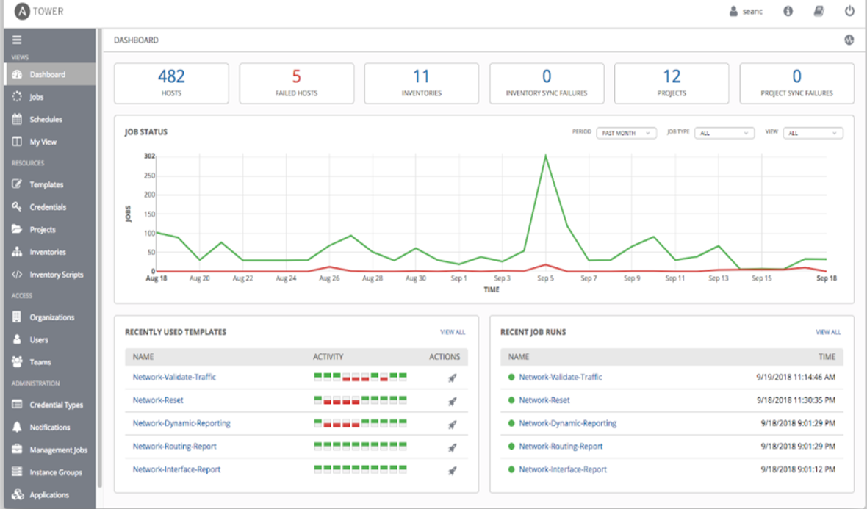
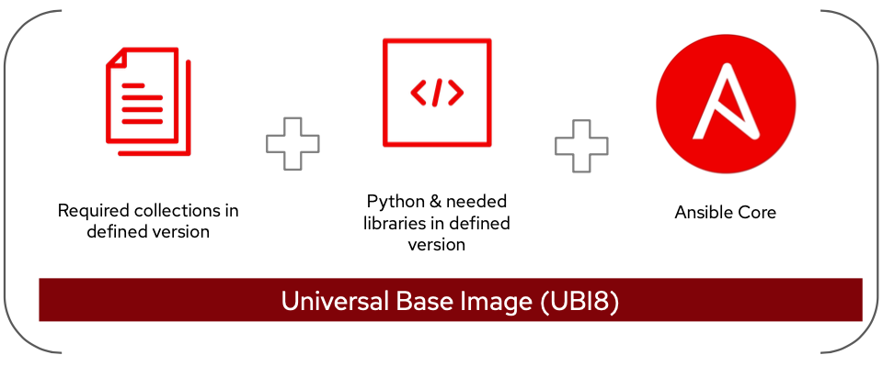

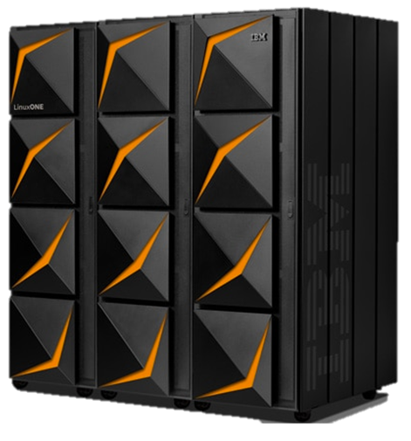
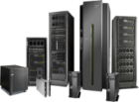

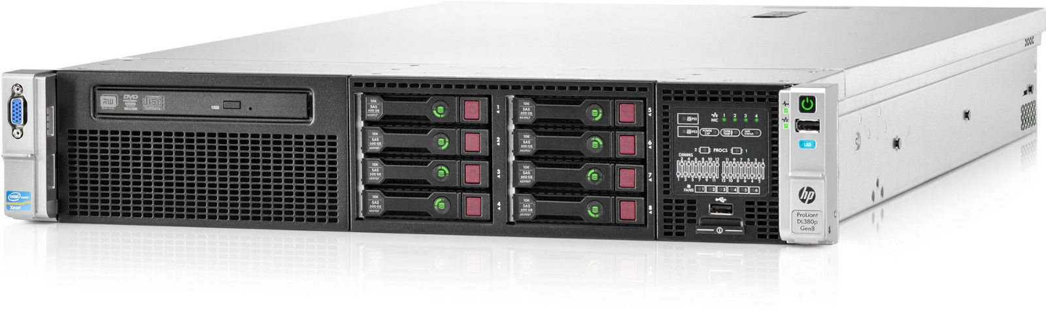

Red Hat Ansible Automation Platform 2.x for IBM Power (Made generally available on December 2nd, 2021 – link to more details)
Automation Controller
Execution Environments
{ containerized }
Endpoints
IBM Power
IBM Z
x86
Ansible Automation Controller
Enterprise-wide graphical management of multi-platform Ansible estate
Ansible Execution Environments
Execution plane for automation
Contains Ansible Core, Python and Collections – all containerized
Ansible Endpoints
Enterprise-wide automation; modules are executed here
commercial support available from Red Hat
Supported on x86 Linux
Supported on x86 Linux (requires podman container runtime)
← new in 4Q2021

Slide 28
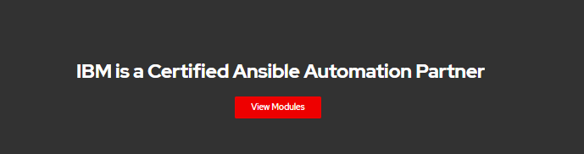
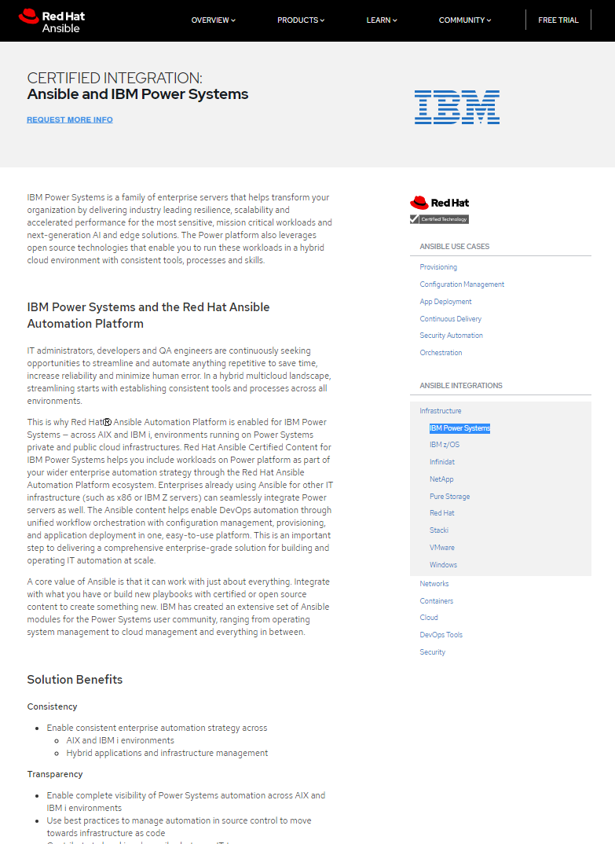
Ansible Automation Platform integrates with IBM Power
IBM Power has been added to the Certified Integrations section of the Red Hat Ansible Web site
https://www.ansible.com/integrations/infrastructure/ibm-power-systems
Ansible modules for Power | Downloads (May 2022)
AIX Collection | 55,685
HMC Collection | 23,136
IBM i Collection | 14,433
VIOS Collection | 14,596
Linux on Power Collection | TBD
PowerHA Collection | [Coming Soon]
Oracle on Power Collection | [Coming Soon]
SAP on Power Collection | [Coming Soon]
Notes:
The various Ansible Collections for IBM Power, which have been downloaded more than 100,000 times by Power customers, are now included in the Red Hat Ansible Automation Platform. As a result, these modules are covered by Red Hat’s 24x7 enterprise support team, which collaborates with the respective Power development teams.

Slide 29
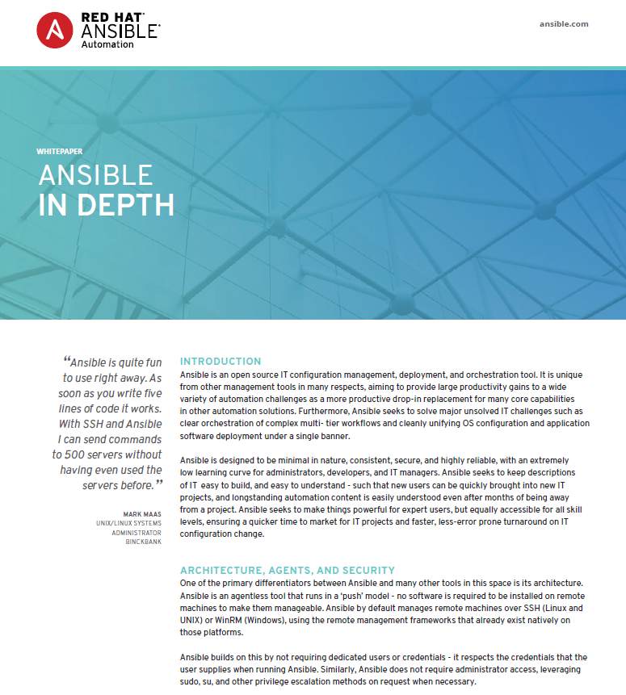
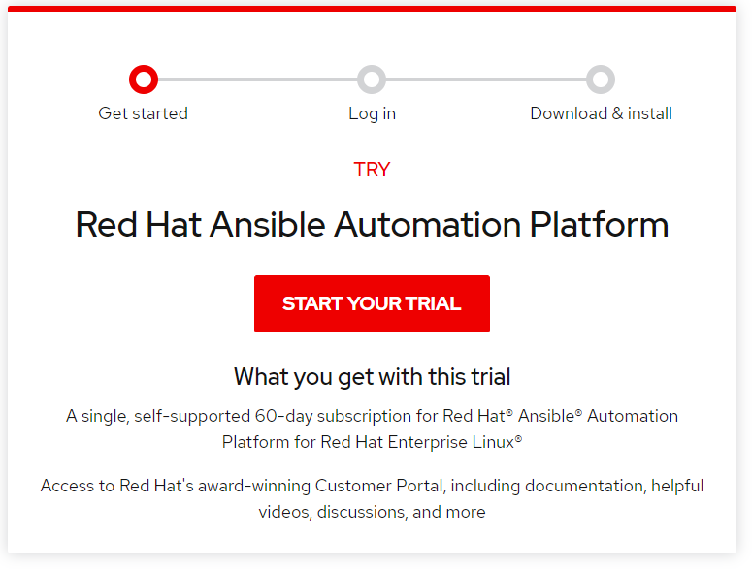
Ansible for IBM Power: Resources
White Paper: Ansible in Depth
https://www.ansible.com/hubfs/pdfs/Ansible-InDepth-WhitePaper.pdf
Red Hat Ansible Automation Platform – Power Systems integration:
https://www.ansible.com/integrations/infrastructure/ibm-power-systems
Ansible Galaxy – open source repository of Power modules
https://galaxy.ansible.com/search?keywords=ibm%20and%20power
Automate AIX and IBM i Admin tasks with Ansible (Red Hat Webinar):
https://www.ansible.com/resources/webinars-training/automate-aix-and-ibm-i-admin-tasks-with-ansible-content-webinar
Red Hat Ansible Automation Platform trial:
https://www.redhat.com/en/technologies/management/ansible/try-it
Ansible documentation:
https://docs.ansible.com/ansible/latest/index.html
Introduction to Ansible for Power (demo video): ibm.biz/ansible-power-trailer
Using Ansible for AIX (demo video): ibm.biz/ansible-aix
Using Ansible for IBM i (demo video): ibm.biz/ansible-i
Notes:
Power customers can download and install a trial of Ansible Automation Platform to get started with IT automation for Power servers. The Ansible Galaxy is a popular repository of open-source Ansible modules. Other downloadable materials include white papers, Webinars, blogs and videos.

Slide 30
Power software updates enhance new Power10 models
HMC and vHMC V10R1M1020
Cloud Management Console (CMC) 1.17
PowerVM 3.1.3 SP
(includes VIOS 3.1.3 SP)
PowerVC 2.0.3
Notes:
Supporting the Power10 scale-out server release will be the updated HMC/vHMC V10R1M10120, along with updates to CMC, PowerVM, VIOS and PowerVC.

Slide 31
IBM sign-off

